Slide 1




Market Basket Analysis : Simplifying Customer Insights

Slide 2
Contents
Problem Definition
Design Thinking
Visualization
Recommendations
Conclusion

Slide 3
Problem Definition
Our challenge is to explore a provided dataset, aiming to uncover hidden patterns and intricate associations between products. At its core, our objective is to discern and comprehend customer purchasing behavior with precision, pinpointing nuanced cross-selling opportunities for a retail enterprise. This undertaking demands the precise application of the Apriori algorithm and astute interpretation of data.

Slide 4
Design Thinking
Data Source:
Source a transaction dataset containing intricately detailed product purchase records. For this purpose we have used the dataset provided in Kaggle
Dataset Link: https://www.kaggle.com/datasets/aslanahmedov/market-basket-analysis
Data Preprocessing:
Cleanse the data, addressing any missing values, duplicates, or inconsistencies with care, ensuring data reliability and for the algorithm to work efficiently on the dataset.
Apriori Algorithm:
Implement the Apriori algorithm to unveil frequent item sets, revealing not just customer preferences but the subtle associations between products which are frequently brought together.
Insights Interpretation:
Carefully decode and dissect complex association rules, capturing the nuances of customer behavior patterns with precision

Slide 5
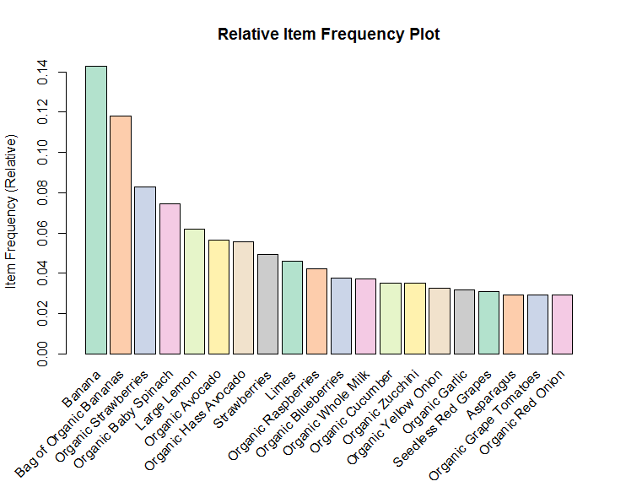
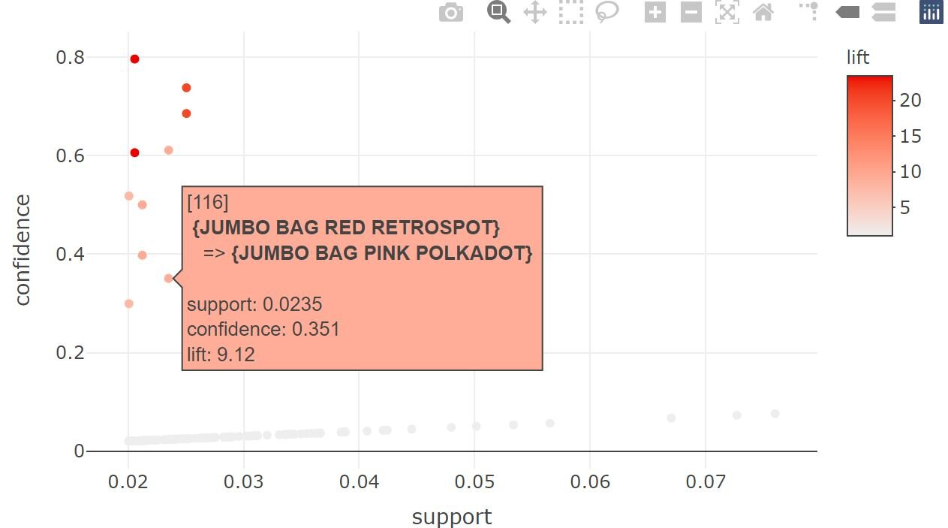
Visualisation
Leverage sophisticated visualizations such as charts and diagrams, elevating the presentation of discovered associations for a better clarity and understanding .

Slide 6
Recommendation & Conclusion
Recommendation:
Craft actionable, data-driven recommendations grounded in deep insights. These recommendations are designed to optimize product offerings, enhance customer satisfaction, and tailor marketing strategies. The objective is to create a shopping environment that resonates with customers, driving sustainable growth and long-term customer loyalty.
Conclusion:
In summary, our exploration of Market Basket Analysis has decoded intricate customer behaviors. These insights provide a strategic compass, guiding us to optimize product offerings and elevate customer satisfaction. This journey has equipped us with actionable knowledge, paving the way for informed decisions and enhanced retail strategies, ensuring our business thrives in a customer-focused landscape.

